Slide 1


Challenges and practices of using machine learning in healthcare data Michael Hurst – Principal Data Scientist
http://bit.ly/HEORMike
https://twitter.com/mikehurst

Slide 2
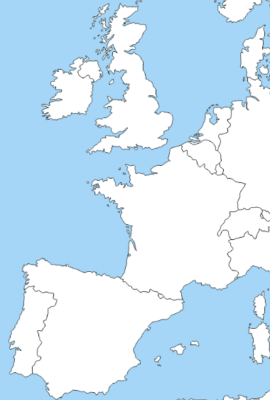

About Us
Birmingham, UK
HEOR – Health Economics and Outcomes Research Ltd.
Health economics consultancy formed in Cardiff in 2012
A team of 60 medical writers, analysts, modellers, data scientists and statisticians across three locations
heor.co.uk
bit.ly/HEOR_Ltd
twitter.com/heor_ltd
Cardiff, UK
Cologne, Germany

Slide 3
Health Economics
Undertaken primarily once a technology has been approved for use (EMA, FDA etc.)
Evidence based research (published literature; clinical trials; observational studies; databases)
Demonstrating the value of an intervention (versus current practice)
Value ≠ just cost
Also taking into account differences in life expectancy and quality of life achieved
Value derived from mathematical models, simulating patient cohorts and expected outcomes
Assisting pharmaceutical companies in preparing submissions to NICE, SMC, AWMSG etc. to provide market access

Slide 4
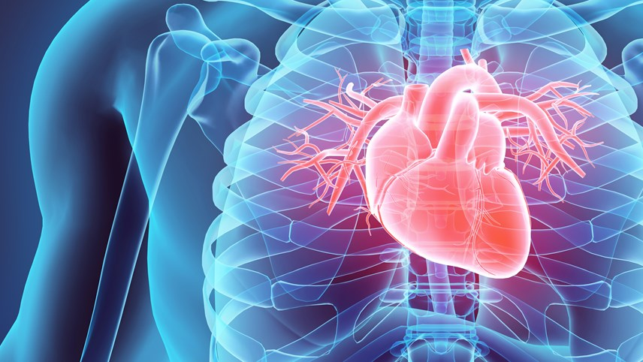
Case Study
Atrial fibrillation/flutter (AF/F)
Irregular heart rate, if undiagnosed can lead to severe complications including stroke and heart failure
Treatment typically consists of direct acting oral anticoagulants (DOAC)
Significant value in diagnosing patients as undiagnosed AF/F can lead to poor outcomes due to complications
NHS key prevention strategy
Increased diagnoses = Increased uptake

Slide 5
Case Study
Predicting atrial fibrillation or atrial flutter (AF/F) using primary care electronic patient health records in the UK using machine learning
In collaboration with two leading pharmaceutical companies with key opinion leaders (KOL) from leading Russell Group universities
To train and evaluate a risk prediction algorithm using UK based primary care data (i.e. GP records)
Project spanning 2017-2020

Slide 6
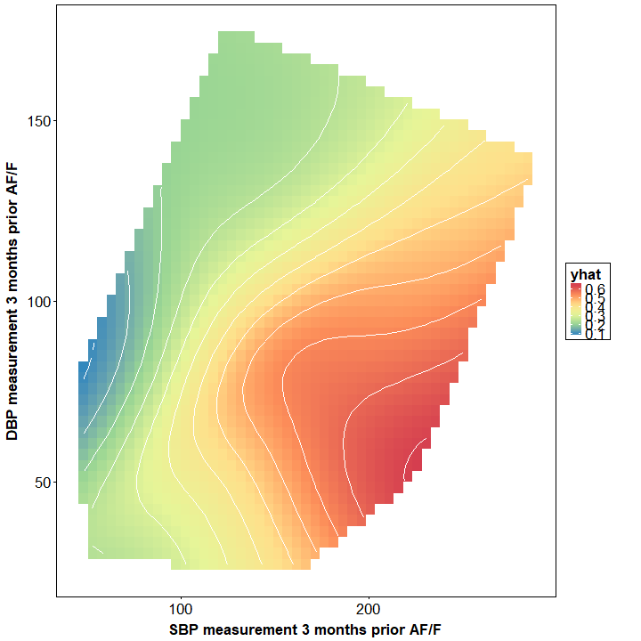
Case Study
 | Predicted Non-AF | Predicted AF
Actual Non-AF | TN | FP
Actual AF | FN | TP
3 million patients spit into 67%/33% training/holdout sets
Dataset consisted of 97% non-AF patients and 3% AF patients
ML algorithm (including NN, SVM’s, random forests) performance compared to traditional risk scores (CHARGE-AF, ARIC, Framingham)
Two methods:
At baseline (complete measurement): Assessment of (up to) 11-year risk
1-year preceding diagnosis: Matched cohort assessment of year prior to AF diagnosis
Holdout set using k-fold cross validation of hyperparameters

Slide 7
Data Landscape
Several data-based resources in the UK
Ranging from:
Small (<1,000 patients): Local, disease area specific registries
Large (>10m patients): CPRD primary care data, HES secondary care data
Coding and structuring similar to that of the mid 1980’s
Inconsistent methods: Excel, Access, specialist software, paper notes
Inconsistent access for research purposes
Systems often decentralised sometimes on a department basis with complete lack of APIs
Failed measures in recent years to improve provision

Slide 8

care.data
2013 scheme by NHS England
Prior failure by Google Health
Expand on the principles of the Clinical Practices Research Datalink (CPRD)
Vision GP systems (~10 million active patients)
All households in England were asked whether they wanted to “opt out” of a centralised database of GP records containing anonymised patient records for research/planning purposes
Scheme controversial due to lack of patient awareness (~60% didn’t receive with no national ad campaign) and a heavy focus on the benefits without enough details on opting out
Project was paused numerous times from 2014 and inevitably shelved in 2016

Slide 9

CPRD
Case study utilised CPRD primary care data
Strict guidelines for extracting, storing, processing and disposing of patient data
Ethics, GDPR etc.
Typically, requests surround:
A specific cohort of patients related to a specific disease indication
Specific analytic comparisons/relationships established a priori
Case Study: Request relevant to case study (i.e. machine learning) was:
A broad population (active patients aged ≥ 30 years old)
Comparisons/relationships to be established through unsupervised learning
Significant push back
Machine learning applications now uniquely placed, requiring committee approval

Slide 10
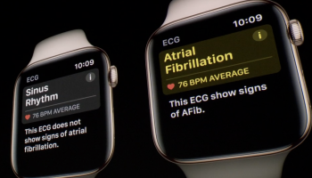
Breaking the Mould
Due to the cost and societal implications, health-based analyses are very traditional
Standardised set of practices, e.g:
The ABPI Code of Practice for the Pharmaceutical Industry
National Institute for Health and Care Excellence (NICE) Technical Support Unit (TSU)
National and International Regulations
Machine learning projects slow to start but now gaining traction
Google AI, Deepmind Health, IBM Watson Health, Kaggle as well as academic projects underway
Apple: AF Apple Watch 4

Slide 11
The Challenges of Healthcare Data
Healthcare data is fundamentally chaotic
Data entry can be at time of consultation or by admin assistant post consultation
Despite coding systems, codes often inconsistently used
E.g. weight measurements
Highly prone to data error
Inconsistency in secondary care recall information
Case Study
Substantial data cleaning/structuring
KOL: “Just give it the data and let the algorithm find the relationships”
A lack of data is of interest

Slide 12
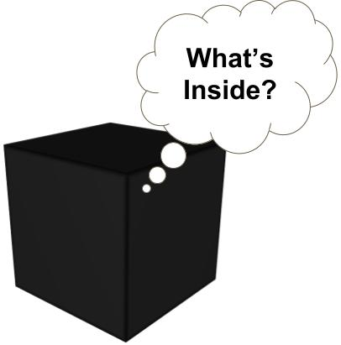
Communicating the Research
Healthcare professionals/custodians are typically a non-tech audience
ML techniques are viewed with scepticism
Getting studies approved/published often comes down to one question:
“What relationships did it found?”
The black-box problem is significant in an industry which is built on justification and accountability
Case study
Leading international journal
Reviewers cited the “speculative” nature and lack of “real evidence”

Slide 13
Next steps
Manuscript currently awaiting publication review
Pragmatic implementation of risk prediction tool
North West London (w/ ICHP) – Assessing the generalisability in a localised dataset
Nationwide – Assessing generalisability in a real-world setting; understanding how tool impacts GP screening procedures
Randomised control trial
Assessing the improvement of AF detection through a priortised intervention

Slide 14
Questions
http://bit.ly/HEORMike
https://twitter.com/mikehurst

